Slide 1

Challenge 4.1
Tan Jia Shun, Do Li Fang Sarah

Slide 2
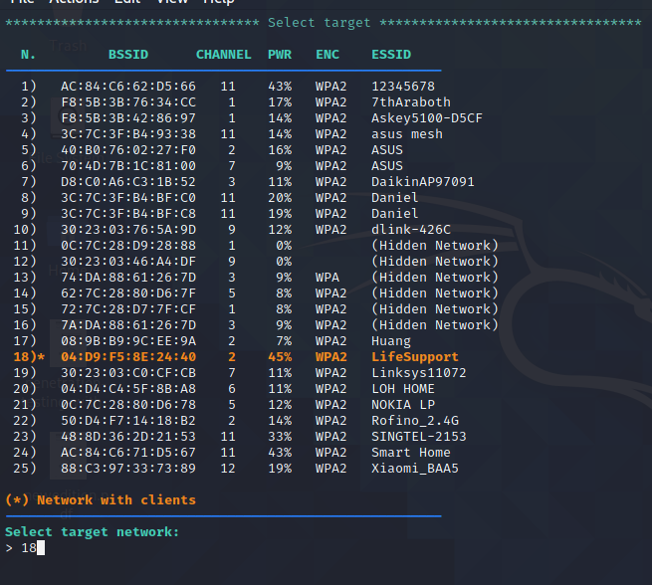
Target
Will crack LifeSupport password

Slide 3
Handshake captured
Cracking the handshake-04:D9:f5:8e:24:40.cap file

Slide 4
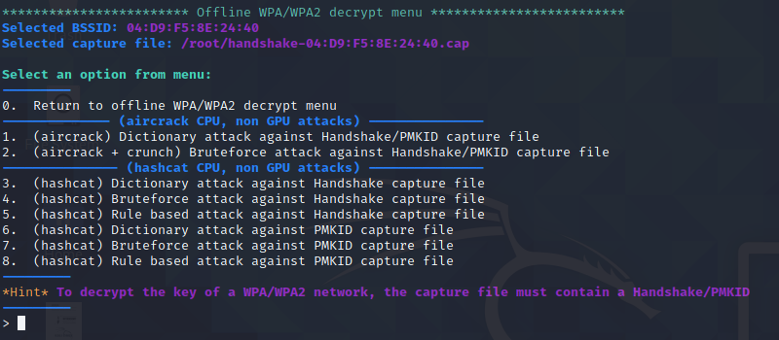
Dictionary attack against handshake capture file using hashcat cpu
Using hashcat dictionary attack to crack the PSK-WPA2 wireless encryption key
Option 3

Slide 5
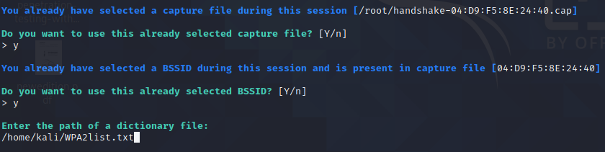
Providing path to dictionary file

Slide 6
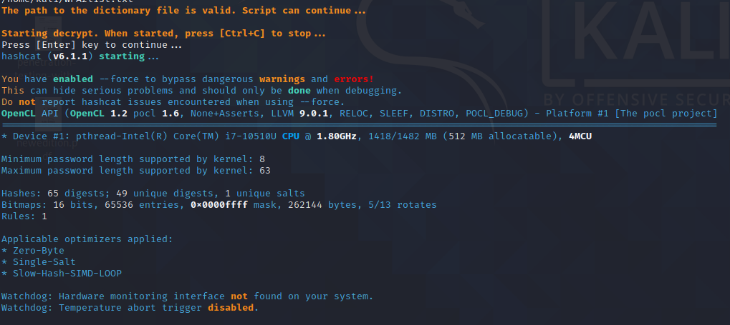
Wait for results

Slide 7
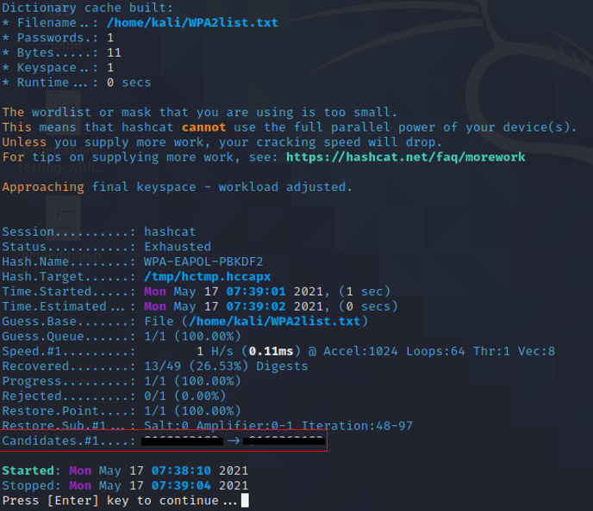
Obtainedwi-fi password
Blurred out for privacy reasons

